Slide 1
Chapter 7
What’s the Attraction?
Types of Attractive Forces
Gases: Attractive Forces Are Limited
Liquids and Solids: Attractive Forces Are
Everywhere
Attractive Forces and Solubility
Dietary Lipids
Attractive Forces and the Cell Membrane

Slide 2
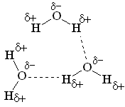
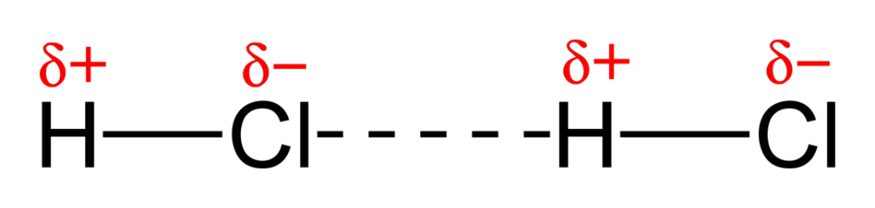
Intermolecular Forces
Intermolecular force: The force of attraction that holds one molecule to another molecule.
The δ⁻ end of one molecule attracts the δ⁺ end of another molecule.

Slide 3
The stronger the intermolecular forces (IMFs) between molecules,
  the better they “stick” to each other
  the more likely the substance will be a liquid… or even a solid
  the higher the boiling point of the substance
  The higher the melting point of the substance
  The slower they evaporate

Slide 4
“Types” of Intermolecular Forces of Attraction
London Dispersion Forces (LDFs)
  Attractive force between ALL covalent molecules
Dipole-dipole attractions
  Additional attractive forces between “regular” polar molecules
Hydrogen “bond” attractions
  Attractions between polar molecules with an O-H, N-H or F-H bond.
Ion-dipole force
  occurs between ionic charges and polar molecules such as water.

Slide 5
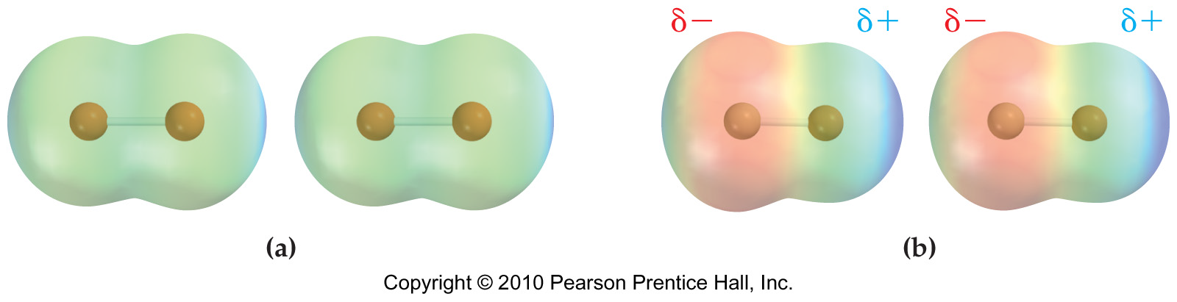
London Dispersion Forces
Nonpolar molecules don’t have permanent partial charges to attract each other with.
BUT… as it turns out, ALL molecules have the ability to form temporary poles due to the random fluctuation of the electron cloud around the molecule.

Slide 6
London Dispersion Forces
The force of attraction between 2 molecules using their temporary partially charged poles is called a London Dispersion Force of attraction (LDF).
The more TOTAL electrons a molecule has, the greater its LDFs are

Slide 7
Dipole-Dipole Forces
“Dipole” is a synonym for “polar molecule”
In addition to LDFs, polar molecules ALSO have the additional “sticking power” that occurs when the partial negative end of one molecule attracts the partial positive end of a neighboring molecule.

Slide 8
Dipole-Dipole Forces
So the attraction between 2 dipoles (2 polar molecules) would be called a dipole-dipole attraction.
And don’t forget… these molecules ALSO experience LDFs between them.
10.1

Slide 9
Hydrogen Bonding
Hydrogen “bonds” are NOT really bonds at all… they are IMFs that are about 25x weaker than covalent bonds
They are simply extra strong dipole-dipole forces.
It’s an extra strong dipole-dipole attraction BETWEEN molecules where…
The hydrogen from an -O-H, -N-H or F-H group of one molecule…
… is attracted to an O, N, or F of a neighboring molecule.

Slide 10
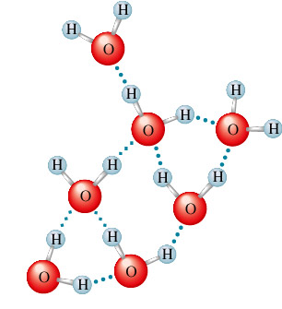
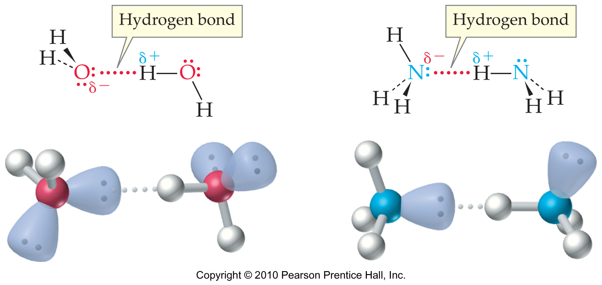
Example of Hydrogen bonding

Slide 11
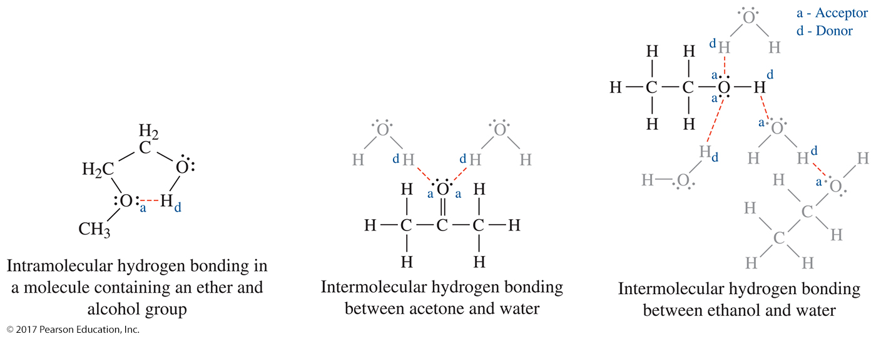
Additional Hydrogen Bonding Examples

Slide 12
Ranking of Intermolecular Forces (IMFs)
For similarly-sized molecules, the ranking of IMFs is
H-bonding + LDFs > D-D + LDFs > LDFs only
(Use LDFs as a “tie breaker” only if the types of IMFs are the same.)

Slide 13
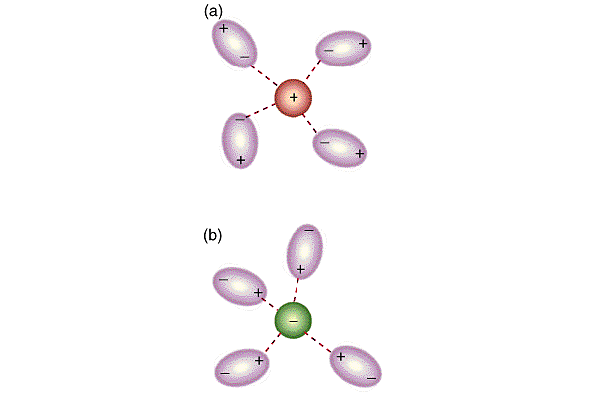
Ion-dipole force exists between an ion and the partial charge on the end of a polar molecule
Notes:
Brown, T., E. LeMay, and B. Bursten. 2000. Chemistry: The Central Science. 8th ed. Phils: Pearson Education Asia Pte. Ltd. p. 396
“Polar molecules are dipoles; they have a positive end and a negative end.”
“Positive ions are attracted to the negative end of a dipole, whereas negative ions are attracted to the positive end.”

Slide 14
Overview of Particle Forces
Type of Force Relative Strength Present in Examples
Dispersion Force
(London Force)
Weak, increasing with size
atoms/molecules
H₂ (g)
Polar molecules
HCl
Dipole-dipole force
moderate
Molecules with hydrogen bonded to N,O, or F
Hydrogen bond
Strong
HF, NH₃, H₂O
Ion-dipole
Very strong
Mixtures of ionic and polar compounds
Na⁺,Cl⁻, and H₂O

Slide 15
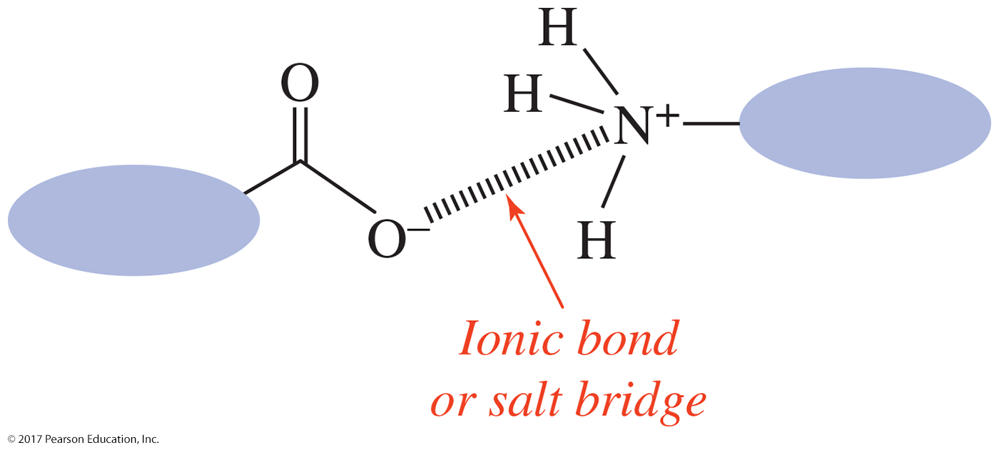
Ionic Compounds
In ionic compounds, ionic bonds
require large amounts of energy to break.
hold positive and negative ions together.
explain their high melting points.

Slide 16
Practice
Identify the main type of attractive forces for each of the following compounds: ionic bonds, dipole–dipole, hydrogen bonds or dispersion.
1. NCl₃
2. H₂O
3. Br₂
4. KCl
5. NH₃

Slide 17
Properties of Gases
Gases differ from solids and liquids in the following ways:
A sample of gas assumes both the shape and volume of the container.
Gases are compressible.
The densities of gases are much smaller than those of liquids and solids and are highly variable depending on temperature and pressure.
Gases form homogeneous mixtures (solutions) with one another in any proportion.

Slide 18
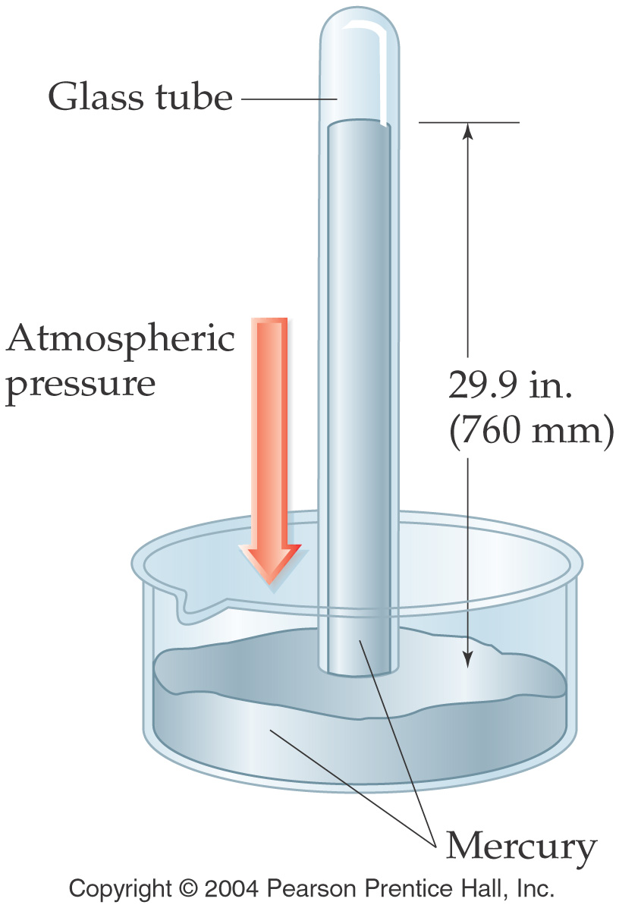
What is pressure and Common units of pressure
101.325 kPa
= 760 mm Hg
= 760 torr
= 1 atm
= 30 in Hg
= 14.7psi

Slide 19
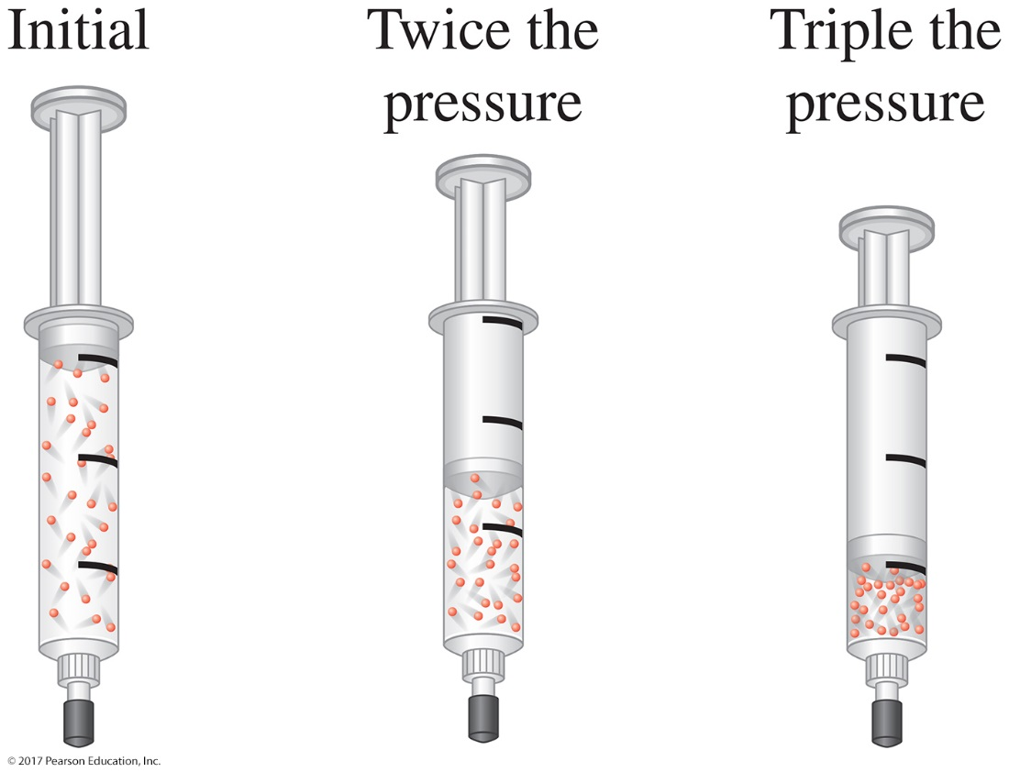
The Gas Laws
Boyle’s law states that the pressure of a fixed amount of gas at a constant temperature is inversely proportional to the volume of the gas.
P₁V₁ = P₂V₂
at constant temperature

Slide 20
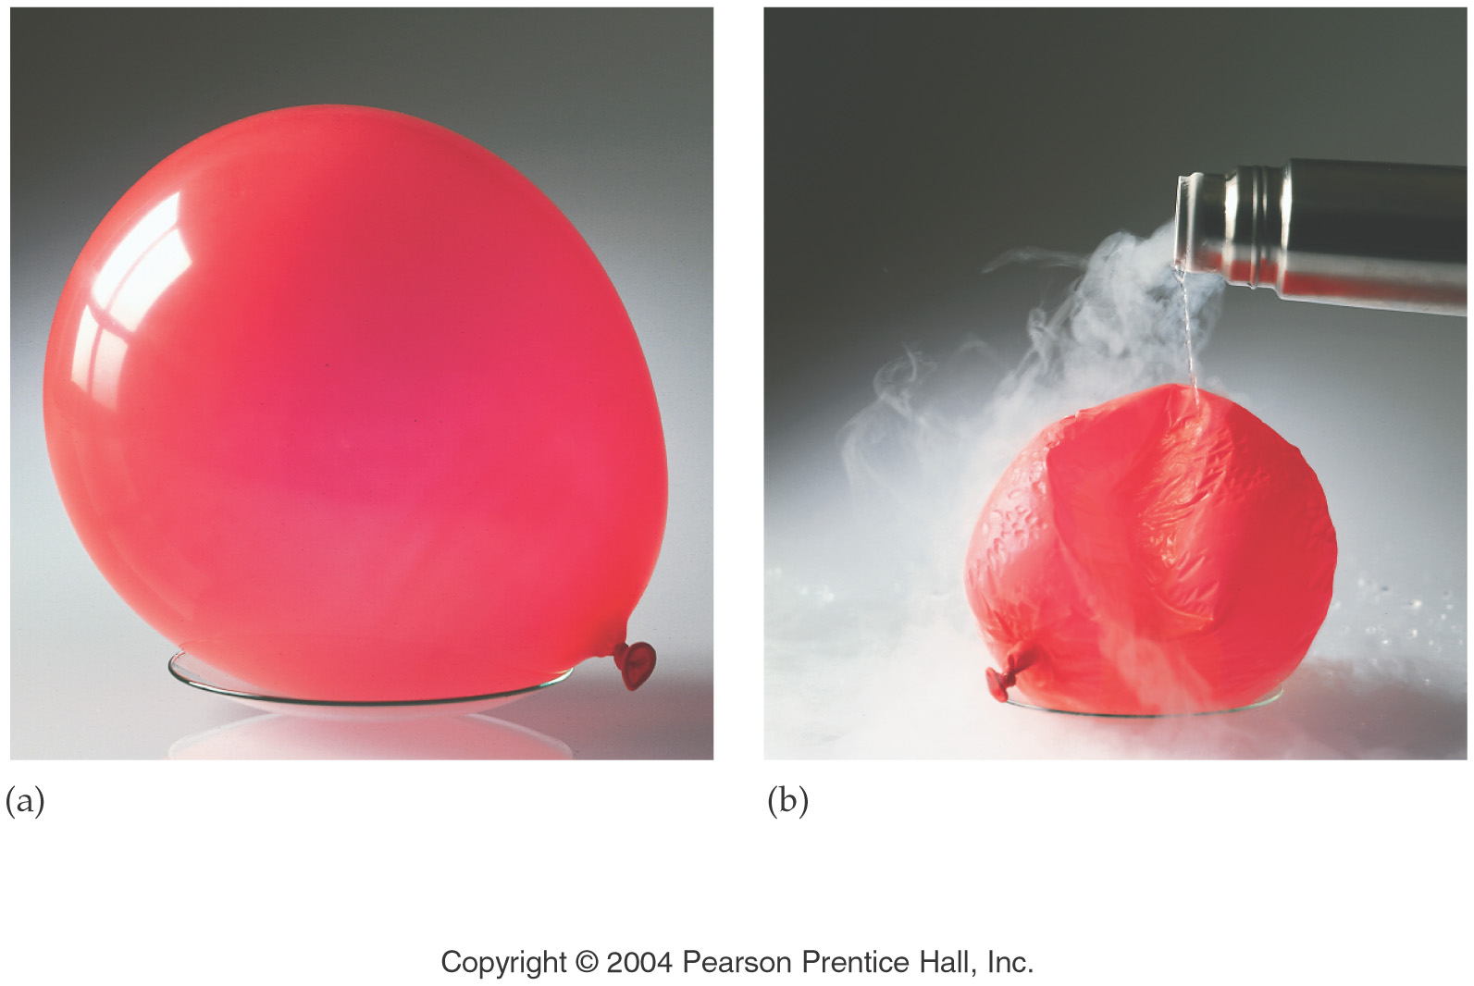
The Gas Laws
Charles’s and Gay-Lussac’s law, (or simply Charles’s Law) states that the volume of a gas maintained at constant pressure is directly proportional to the absolute temperature of the gas.
at constant pressure
Temperature must always be in Kelvin

Slide 21
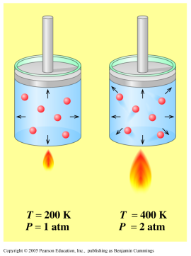
The Gas Laws
  Gay-Lussac’s law: The Volume of a sample of gas at constant pressure will vary directly with temperature.
  Temperature
  must always be
  in Kelvin
  Temperature & pressure
  As P↑ then T↑
  At constant V, n

Slide 22
Gas Laws
If we combine all of the relationships from the 3 laws covered thus far (Boyle’s, Charles’s, and Gay-Lussac’s) we can develop a mathematical equation that can solve for a situation where 3 variables change :
PV=k₁
V/T=k₂
P/T=k₃
P₁V₁
P₂V₂
P₁V₁T₂ = P₂V₂T₁
=
OR
T₁
T₂

Slide 23
Practice
Calculate the volume of a sample of gas at 5.75 atm if it occupies 5.14 L at 2.49 atm. (Assume constant temperature.)
A sample of argon gas that originally occupied 14.6 L at 25°C was heated to 50.0°C at constant pressure. What is its new volume?
A gas has a pressure of 645 torr at 128°C. What is the temperature in Celsius if the pressure increases to 1.50 atm (n and V remain constant)?
For example: If I initially have a gas at a pressure of 12 atm, a volume of 23 L and a temperature of 200 K, then I raise the pressure to 14 atm and increase the temperature to 300 K, what is the new volume of the gas?

Slide 24
The Ideal Gas Equation
The ideal gas equation (below) describes the relationship among the four variables P, V, n, and T.
PV = nRT
An ideal gas is a hypothetical sample of gas whose pressure-volume-temperature behavior is predicted accurately by the ideal gas equation.
The constant R is the ideal gas constant and has a value of 0.0821 atm⋅L/mol⋅K

Slide 25
Practice
Dinitrogen oxide (N₂O), laughing gas, is used by dentists as an anesthetic. If a 20.0 L tank of laughing gas contains 2.86 mol N₂O at 23°C, what is the pressure (mm Hg) in the tank?

Slide 26
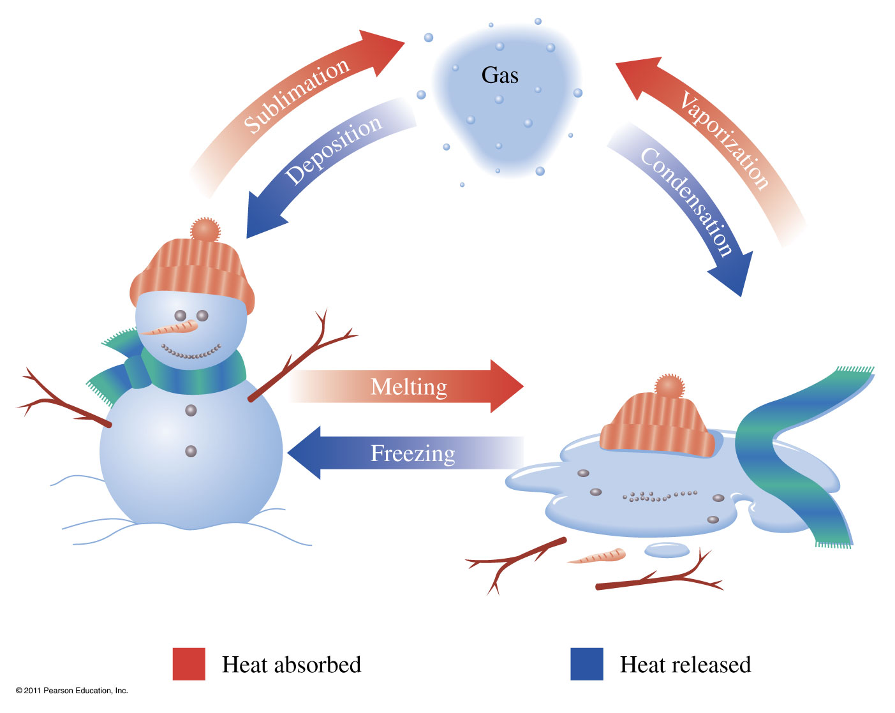
Phase Transitions
Vaporization Liquid to gas transition Condensation Gas to liquid transition
Melting Solid to liquid transition Freezing liquid to solid transition
Sublimation Solid to gas transition Deposition Gas to solid transition

Slide 27
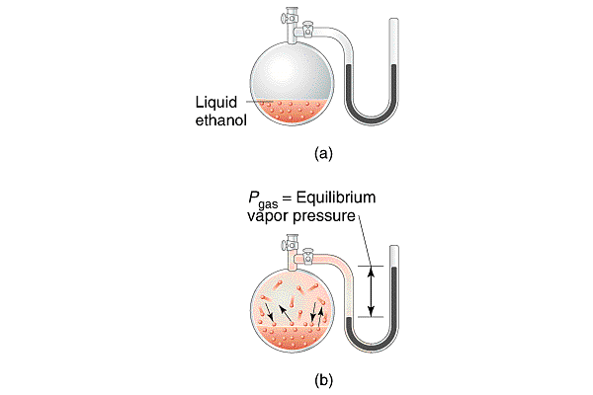
Vapor Pressure of Liquids
Once molecules have escaped from the liquid into the gas state, the pressure they exert is called the vapor pressure of the liquid.

Slide 28
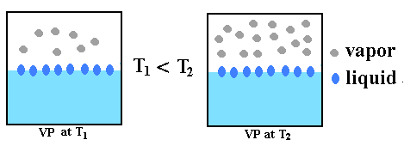
Vapor Pressure of Liquids
At higher temperatures, there are more molecules with enough KE to escape…
So the vapor pressure increases
Boiling point: the temperature at which the vapor pressure of a liquid is equal to the atmospheric pressure.

Slide 29
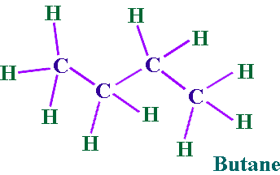
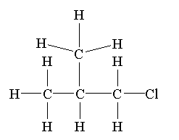
Shape also matters
0
Butane, bp -0.5 degrees C
2-methylpropane -11.7 degrees C
Butane has a higher boiling point because the dispersion forces are greater. The molecules are longer (and so set up bigger temporary dipoles) and can lie closer together than the shorter, fatter 2-methylpropane molecules.
Also, the molecules can stack with each other better

Slide 30
Practice
Rank the following compounds in order of increasing
boiling point (number them 1-4 from lowest to highest):

Slide 31
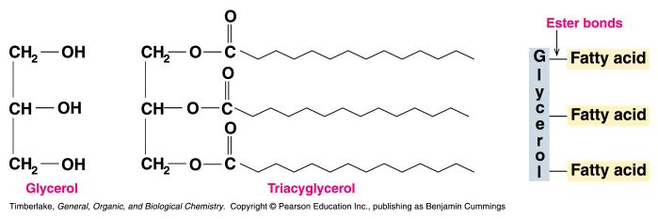
Triacylglycerols
Triacylglycerols (also called triglycerides) are tri-fatty acid esters of glycerol
Triacylglycerols are the major form of fatty acid storage in plants and animals
Triacylglycerols can be classified as fats or oils
- fats are solid at room temperature and most come from animals
- oils are usually liquid at room temperature and come from plants (palm and coconut oils are solids at room temperature)

Slide 32
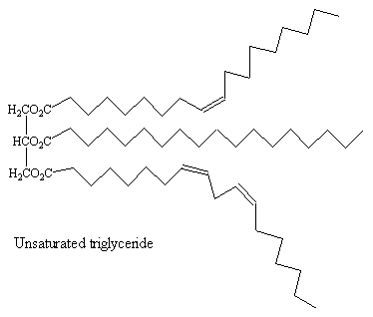
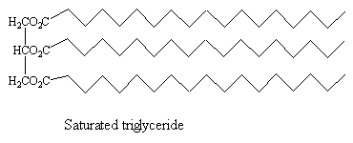
Triglycerides
In unsaturated triglycerides,
the molecules can not stack (liquid
oil)
In the saturated molecules, the
fatty acids are tightly packed and
Stacked (solid, fat)

Slide 33
A triglyceride is made of two oleic acids and one linolenic acid.
Oleic acid: CH₃(CH₂)₃CH=CH(CH₂)₇COOH
Linolenic acid: CH₃CH₂(CH=CHCH₂)₃(CH₂)₆COOH
a) draw the structure of this triglyceride.
b) Is this triglyceride a fat or an oil? Explain why.

Slide 34
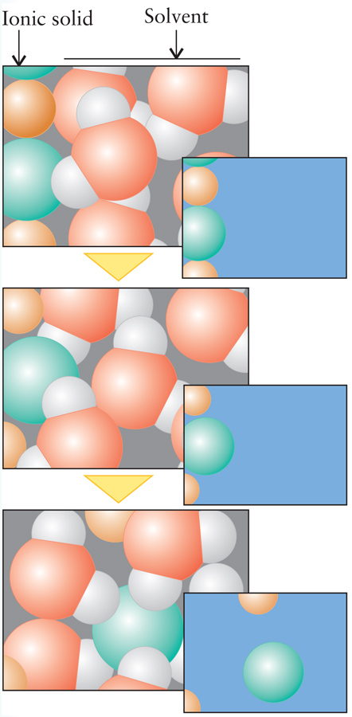
Limits of Solubility
When we dissolve a solid in some liquid, what is actually happening?
  Take glucose added to water
    H-bonding between water molecules and glucose molecules pulls the individual molecules into solution
    H-binding and Van der Waals interactions keep the glucose held together as a solid

Slide 35
Like Dissolves Like
It all comes down to intermolecular forces…
When we dissolve something, we replace some of the specific intermolecular forces in the solution with the same kind of interactions with the solute.
Water (polar, hydrogen bonding solvent) will work well to dissolve polar or ionic solutes
Fatty stains like gravy or butter can be removed with organic solvents like hexane or dichloroethene

Slide 36
Example - Solubility
Which of the following pairs are miscible?
Water and ethanol, CH₃CH₂OH
Hexane, CH₃(CH₂)₄CH₃ and xylene,
Ethanol, CH₃CH₂OH, and xylene,
A and B
All of the above

Slide 37
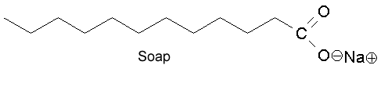
Soap is an excellent cleanser
non-polar CH₂ units; ionic COO⁻Na⁺ group
soap acts as an emulsifying agent
it can disperse a liquid into another immiscible liquid.
Amphipathic molecules contain both polar (hydrophilic) and non-polar (hydrophobic) groups
  They can thus interact both with solvent water and with each other

Slide 38
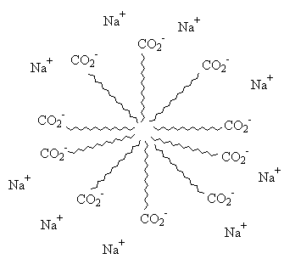
A micelle then forms—with nonpolar
solutes in the center.
The outside of the micelle is ionic—water soluble. Hence . . .
grease and oil washed away.

Slide 39
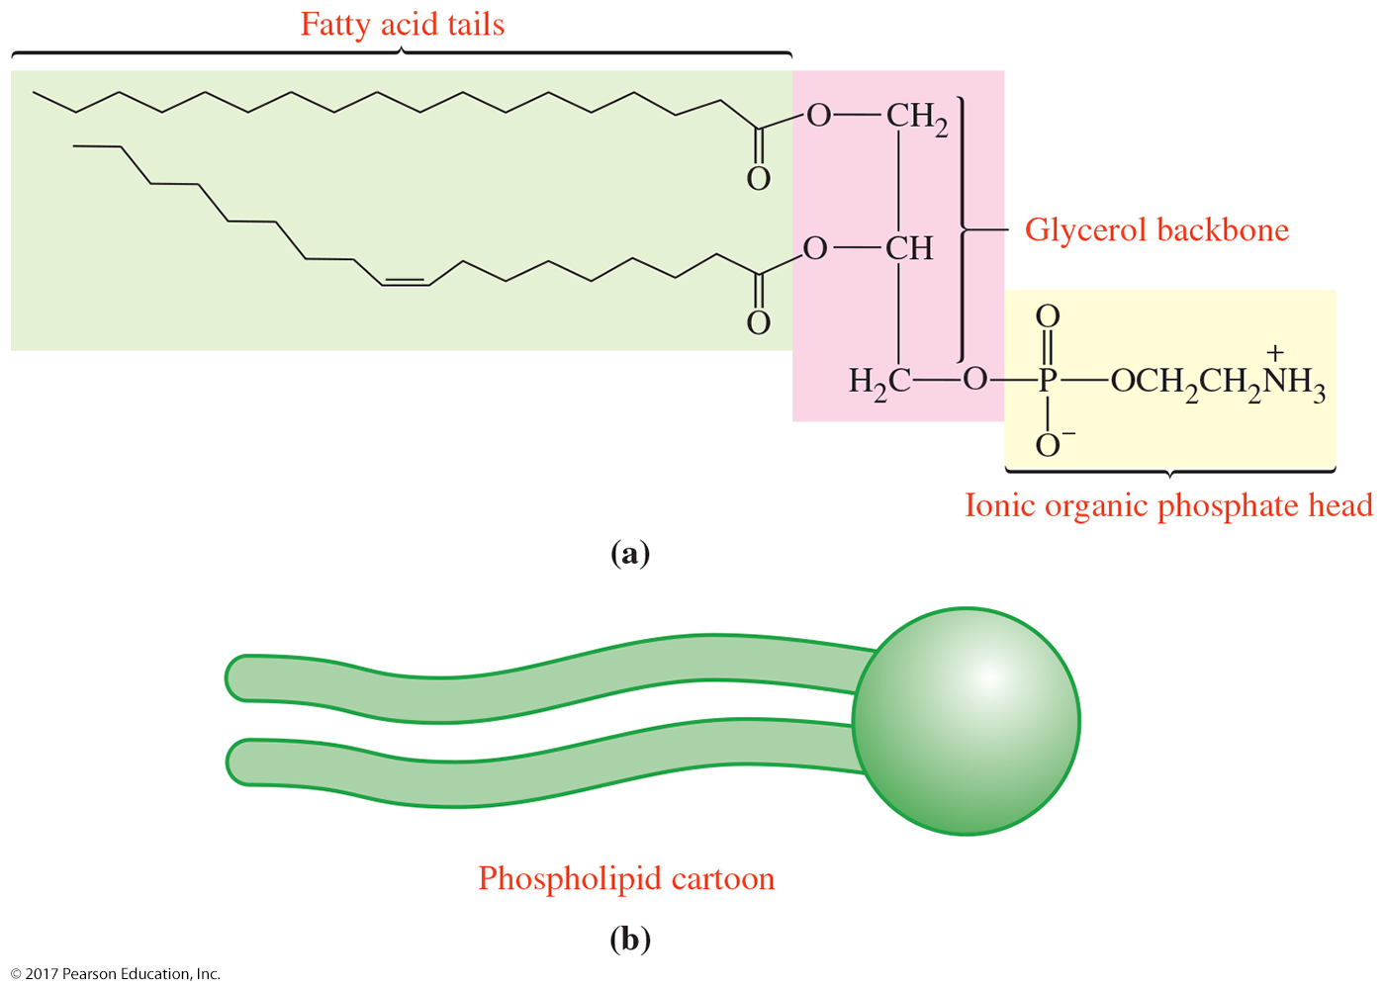
Attractive Forces and the Cell Membrane
© 2017 Pearson Education, Inc.

Slide 40
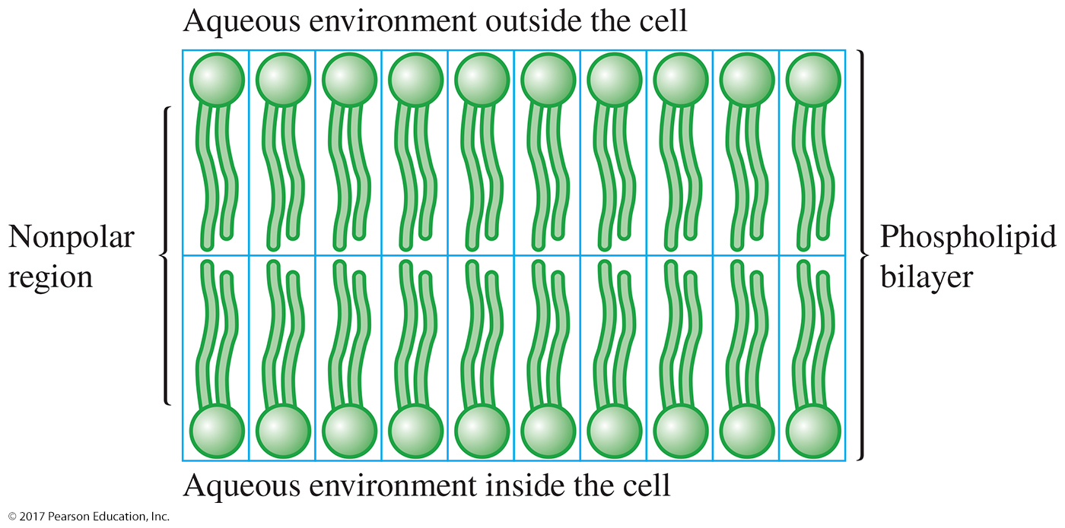
Attractive Forces and the Cell Membrane
© 2017 Pearson Education, Inc.

Slide 41
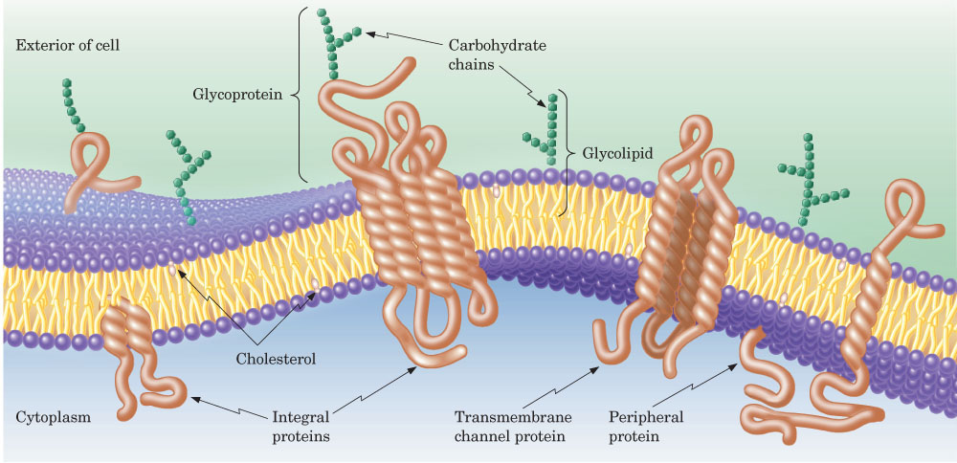
FLUID MOSAIC MODEL OF MEMBRANE STRUCTURE

Slide 42
Lipid membranes surrounding cells have how many layers? Draw the general structure/arrangement of a lipid membrane.

Slide 43
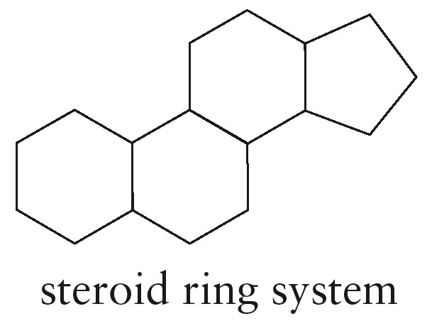
STEROIDS
Steroids are a broad class of compounds that have the same structural feature:
Like all lipids, steroids are soluble in nonpolar solvents.

Slide 44
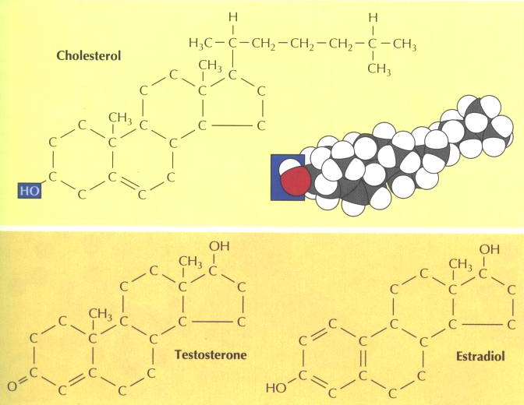
Cholesterol: A membrane component in many animal cells and the starting point for steroid hormone synthesis

Slide 45
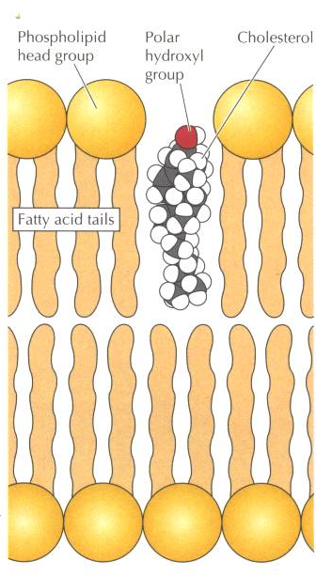
How cholesterol looks in a membrane…..

